Slide 1
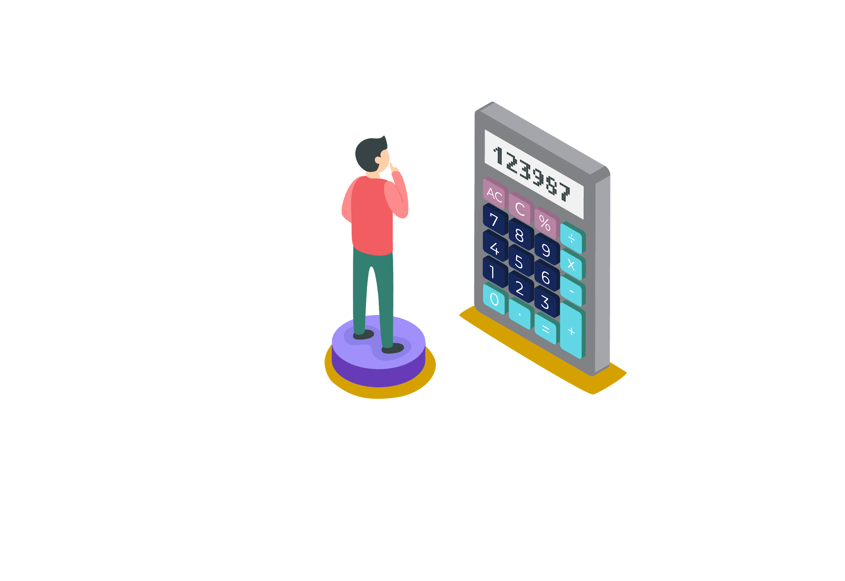

ABHAY MAHAJAN
B.Tech. IIT Roorkee
11+ years teaching experience
Mentored and taught around 20000+ students
Produced 400+ IIT selections
10+ INMO selections
1 EGMO Selection

Slide 2


Slide 3


Slide 4


Slide 5


Slide 6


Slide 7


Slide 8


Slide 9

Content Creator :
Sahil Jindal
B.Tech, NIT Kurukshetra
4 Year JEE Teaching Experience.

Slide 10
Pigeonhole Principle

Slide 11
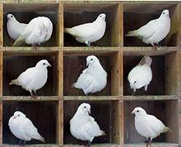
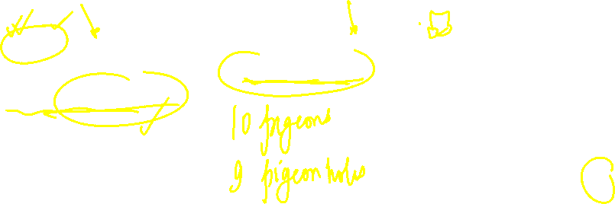
Basic Forms of Pigeonhole Principle
Principle I
When m + 1 pigeons enter m pigeonholes (m is positive integer), there must be at least one hole having more than 1 pigeon.
Notes:
KVPY 2012

Slide 12
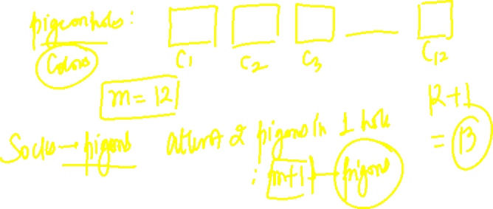
Q. In the morning, John draws socks randomly from his drawer. If there are 12 pairs of socks each pair a different colour, in the drawer, how many socks does John have to draw at most in order to get a matched pair?
Notes:
KVPY 2012

Slide 13
Solution:
There are 12 different colours (pigeonholes) and in order to ensure at least two socks (pigeons) have the same colour,
No. of socks drawn > 12.
So at most 12 + 1 = 13 socks have to be drawn to get a matched pair.
Notes:
KVPY 2012

Slide 14
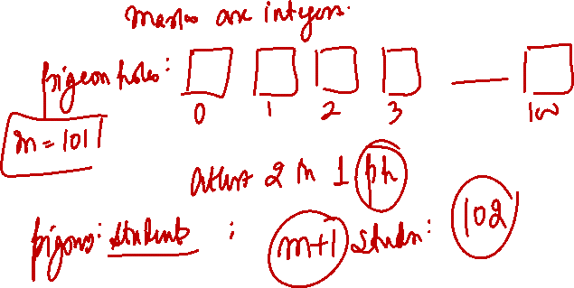
Q. How many students must be in a class to guarantee that at least two student receive the same score on the final exam, if the exam is graded on a scale from 0 to 100 points?
Notes:
KVPY 2012

Slide 15
Solution:
There are 101 possible scores on the final. The pigeonhole principle shows that among any 102 students there must be at least 2 students with the same score.
Notes:
KVPY 2012

Slide 16
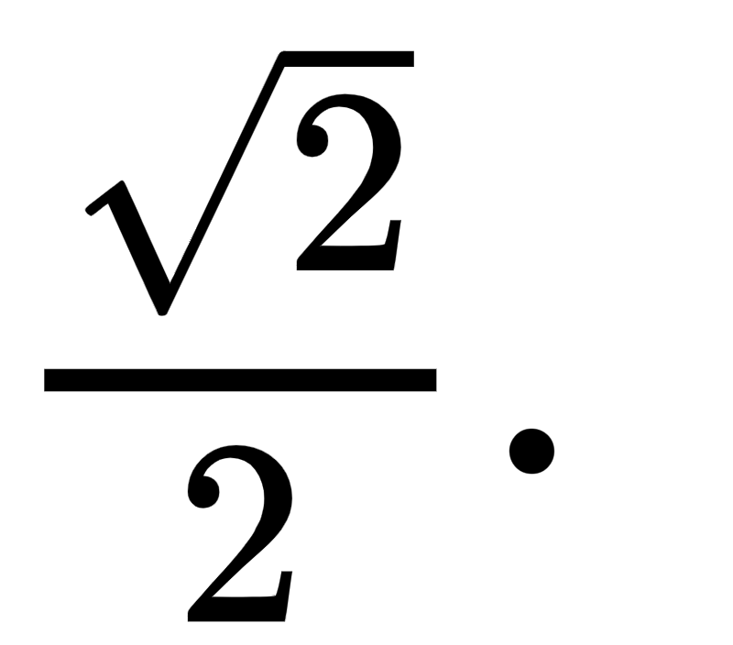

Q. Five points are drawn randomly inside a unit square, show that there is at least two points with a distance less than
Notes:
KVPY 2012

Slide 17


Solution:
Consider a unit square and cut it into 4 equal smaller square, as shown below on the left.
There are 4 equal smaller squares (pigeonholes) and 5 points (pigeons). By the pigeonhole principle, at least two points are in the same smaller square. The distance between these two points < length of the diagonal of the smaller square.
Length of the diagonal =
1/2
1/2
So there is at least two points with a distance less than
Notes:
KVPY 2012

Slide 18

Q. Prove that for any given 50 positive integers, it is always possible to select out four numbers a₁; a₂; a₃ and a₄ from them, such that (a₂ - a₁)(a₄ - a₃) is a multiple of 2009.
Notes:
KVPY 2012

Slide 19
Solution:
First of all, note that 2009 = 49 x 41. Consider the 50 remainders of the 50 given integers modulo 49, by the pigeonhole principle, there must be two numbers selected from the 50 integers, denoted by a₁ and a₂, such that a₁ and a₂ are congruent modulo 49, so a₂ - a₁ is divisible by 49.
Next, by same reason, it must be possible that two numbers a₃ and a₄ can be selected from the remaining 48 numbers such that a₄ - a₃ is divisible by 41.
Thus, 49.41 | (a₂ - a₁)(a₄ - a₃), i.e. 2009 | (a₂ - a₁)(a₄ - a₃).
Notes:
KVPY 2012

Slide 20
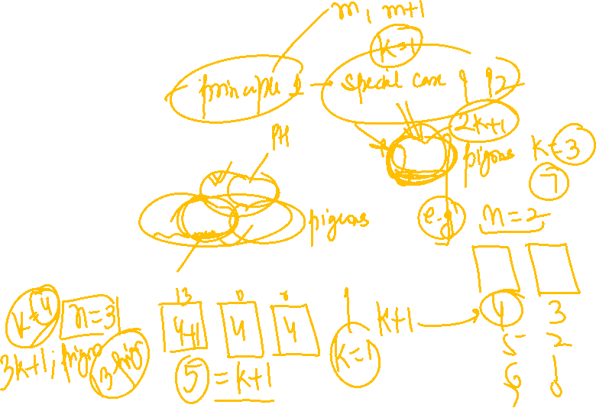
Basic Forms of Pigeonhole Principle
Principle II
Let k and n be any two positive integers. If at least kn + 1 objects are distributed among n boxes, then one of the boxes must contain at least k + 1 objects.
In particular, if at least n + 1 objects are to be put into n boxes, then one of the boxes must contain at least two objects.
Notes:
KVPY 2012

Slide 21
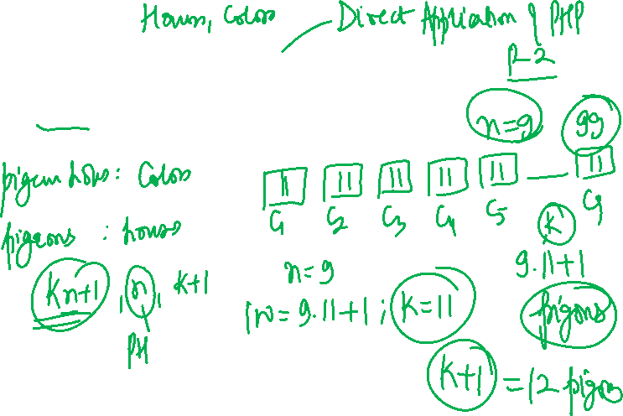
Q. Show that if 9 colours are used to paint 100 houses, then at least 12 houses will be of the same colour.
Notes:
KVPY 2012

Slide 22

Solution:
We have 9 colours (pigeonholes) and 100 houses (pigeons). By the generalized pigeonhole principle, there is at least one colour that will be used to paint at least houses.
So there is at least 12 houses painted with the same colour.
Notes:
KVPY 2012

Slide 23
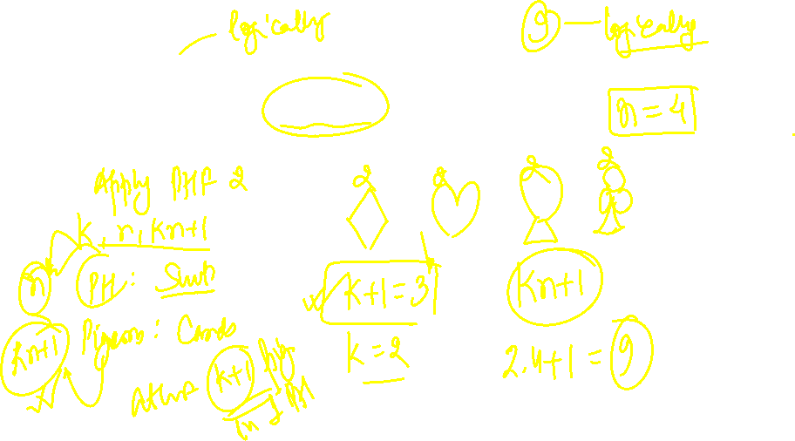
Q. How many cards must be selected from a deck of 52 cards to make sure that at least 3 cards of the same suit are selected?
Notes:
KVPY 2012

Slide 24

Solution:
We have 4 suits (pigeonholes) and if all of them does not appear with at least 3 card (pigeons), i.e. each suit has at most 2 cards, then the maximum number of cards that can possibly be drawn is (4). (2) = 8.
So the number of cards that must be drawn to ensure at least 3 cards are of the same suit is 8 + 1 = 9
Alternatively, let there be n cards drawn, then according to the generalized pigeon principle,
So at least 8 + 1 = 9 cards to be drawn.
Notes:
KVPY 2012

Slide 25
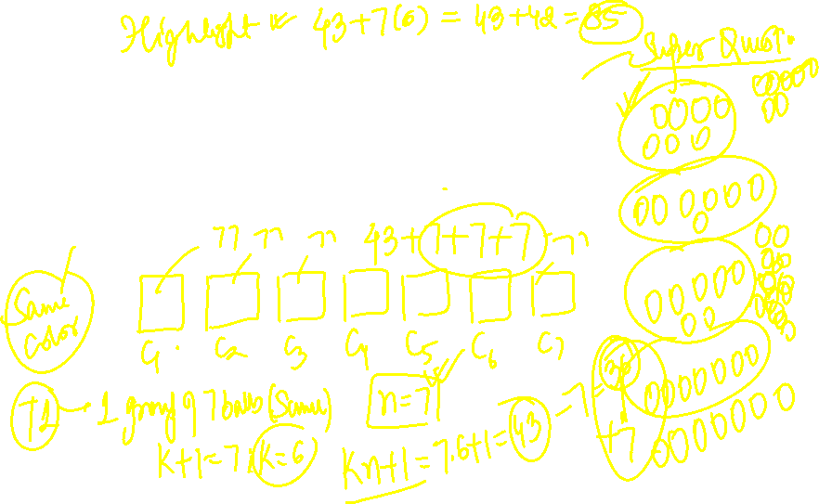
CHINA-2003
Q. In a bag, there are some balls of the same size that
are colored by 7 colors, and for each color the number of balls is 77. At least how many balls are needed to be picked out at random to ensure that one can obtain 7 groups of 7 balls each such that in each group the balls are homochromatic?
Notes:
KVPY 2012

Slide 26
Solution:
For this problem, it is natural to let each color be one pigeonhole, and a ball drawn be a pigeon. At the first step, for getting a group of 7 balls with the same color, at least 43 balls are needed to be picked out from the bag at random, since if only 42 balls are picked out, there may be exactly 6 for each color.
By pigeonhole principle, there must be one color such that at least b42=7c+1 = 7 drawn balls have this color.
Next, after getting the first group, it is sufficient to pick out from the bag
another 7 balls for getting 43 balls once again. Then, by the same reason, the second group of 7 homochromatic drawn balls can be obtained. Repeating this process for 6 times, the 7 groups of 7 homochromatic balls are obtained. Thus, the least number of drawn balls is 43 + 6 x 7 = 85.
Notes:
KVPY 2012

Slide 27

SSSMO - 2001
Q. A bag contain 200 marbles. There are 60 red ones, 60 blue ones, 60 green ones and the remaining 20 consist of yellow and white ones. If marbles are chosen from the bag without looking, what is the smallest number one must pick in order to ensure that, among the chosen marbles, at least 20 are of the same colour?
Notes:
KVPY 2012

Slide 28

Solution:
When 77 marbles are chosen, there may be 19 red, 19 blue, 19 green and 20 yellow and white.
If 78 marbles are chosen at random, the number of yellow and white ones among them is at most 20. Therefore there are at least 58 marbles of red, blue or green colours. According to the Pigeonhole Principle, the number of drawn marbles of some color is not less that
i.e. are least 20. Thus, the smallest number of marble to be picked is 78.
In this problem, a colour is taken as a pigeonhole, and then a drawn marble is taken as a pigeon.
Notes:
KVPY 2012

Slide 29
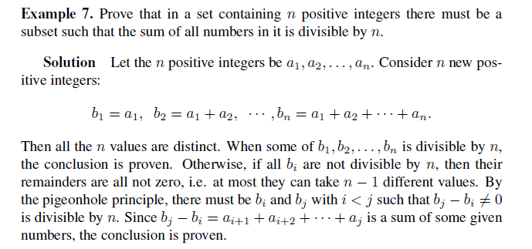
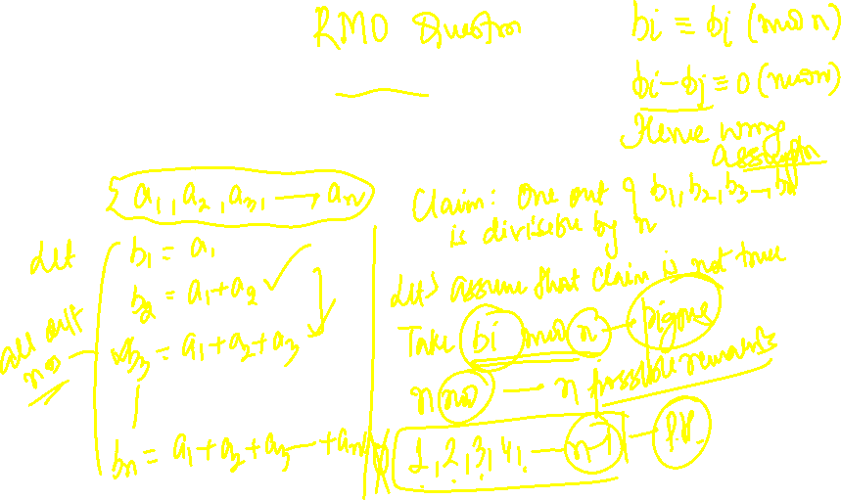
Q. Prove that in a set containing n positive integers there must be a subset such that the sum of all numbers in it is divisible by n.
Notes:
KVPY 2012

Slide 30
Solution:
Let the n positive integers be a₁, a₂,....,a_{n}. Consider n new positive integers:
b₁ = a₁, b₂ = a₁ + a₂, ..... , b_{n} = a₁ + a₂ +.....+ a_{n}.
Then all the n values are distinct. When some of b₁, b₂,....b_{n} is divisible by n, the conclusion is proven. Otherwise, if all b_{i} are not divisible by n, then their remainders are all not zero, i.e. at most they can take n –1 different values. By the pigeonhole principle, there must be b_{i} and b_{j} with i < j such that b_{j} – b_{i} ≠ 0 is divisible by n. Since b_{j} – b_{i} = a_{i + 1} + a_{i + 2} +....+a_{j} is a sum of some given numbers, the conclusion is proven..
Notes:
KVPY 2012

Slide 34




Let’s Bring
GOLD
For
INDIA

Slide 35

If you liked the session, then

